Slide 1
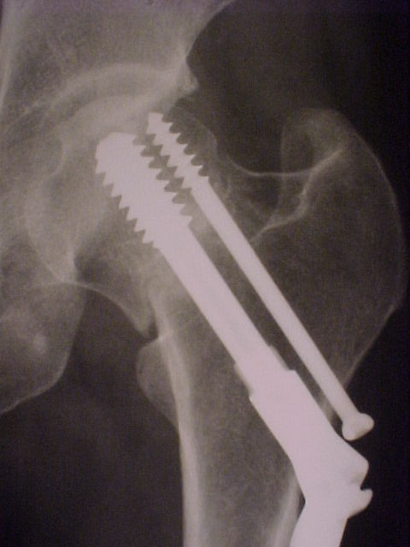
Slide nr.1
Identify ( point) the position of the fracture on the Xray :
They should point the red area
The puprose is tyo identify the position of the fracture; that means that wherever they shoud point in the red area, it is correct, because it is the area of the fracture; the black line identifies specific the fracture, but they have to be able to point the red area
So, if they point- SEE NEXT

Slide 2
Slide nr.1- proceed
d
So, if they point to one of the areas marked in blue, it will not be correct:
Femoral head (a)
Trochanteric region (b)
Hip joint- it is intact, so there is no hip dislocation (d)
a
c

Slide 3
Slide 2
Question:
Which is the type of the fracture?
Femoral head
Femoral neck, Pauwels III
Trochanteric region
Femoral neck, Pauwels II
No fracture, just hip dislocation
Correct answer- b

Slide 4
Slide no.3
Point the two radiological findings concerning the 6.5 mm screw:
( the 6.5 mm screw is the smallest one)
The position of the tip of the 6.5 mm screw- it is situated much too close to the superior border of the femoral head
The head of the 6,5 mm screw- it is not in contact with the bone, so it is not tightened, which reduces its’ stability ; the puprose of this screw is anti-rotational, so, if it is not stable, the femoral head might rotate on the DHS screw ( tha large screw)
They should point the blue and red areas

Slide 5
Slide nr. 4
Answer the question:
The problems concerning of the 6.5 mm screw are:
The tip of the screw is too close to the superior part of the femoral head
The screw is too long
The screw is not touching the external cortex, so it is not tightened , therefore its stability is decreased, impairing its’ function
All the three answers are correct

Slide 6
Slide no.5
Point the radiological finding concerning the dynamic screw:
( the dynamic screw is the largest one).
They should point the area in blue, otherwise they cannot pass to the next slide

Slide 7
Slide 6
Answer the question:
Which of the following answers are correct:
The tip of the dynamic screw is situated much too close to the superior border of the femoral head ( the dynamic screw is the largest one)
The compression screw is not completely tightened, so compression is incomplete
The thread of the dynamic screw is situated within the fracture
The dynamic screw screw is too shortenghts of the screw is to
They should answer the question, correct answers are a and b, otherwise they cannot pass.
The coloured area are for ilustrating the answers, they should not appear on the quiz

Slide 8
Slide 7
Point the position of the fracture on the superior cortex
They should point the blue area

Slide 9
Slide 8
Point the position of the fracture on the inferior cortex
They should point the red area

Slide 10
Slide 9
Answer the question:
Which of the following answers are correct:
The reduction of the fracture is anatomical
The fracture is not reduced, and, due to varus displacement, healing is less probable
The fracture is not reduced, still proper healing is expected, because the fracture is impacted
Vertical aspect of the fracture ( visible on the AP X ray) will impare healing
Correct answers : b, d

Slide 11
Slide 10
Answer the following questions:
The patient is 52 yrs old, active. The correct treatment is:
Leave the implant in place, the fracture will heal
Implant removal and no weight bearing
Implant removal and surgical treatment- CORRECT
Surgical treatment means:
Reduce the fracture through direct approach and stabilisation with DHS
Reduce the fracture through direct approach and stabilisation with 2 paralel screws
Arthroplasty of the hip- CORRECT

